Slide 1


JavaScript Workshop 2
Open Source Track
upGrad School of Technology

Slide 2
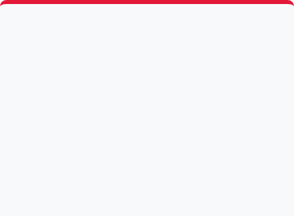
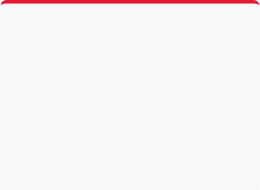



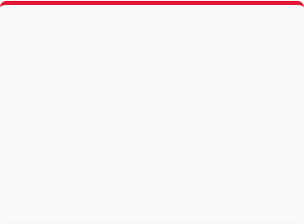



What Are We Building?
upGrad School of Technology
Here's the destination before we start the journey - every topic today exists to build this one project: A Todo App.
Add Task
Delete Task
Mark Complete
Type a task and submit - it appears in the list instantly.
Click the delete icon on any task, even ones added after load, to remove it.
Click a task to toggle a strikethrough style, marking it done.
Validation
Dark Mode
100% Vanilla JS
Empty or whitespace-only tasks are rejected with an inline error message.
One click toggles the whole page between light and dark themes.
No framework, no build step - just HTML, CSS, and pure JavaScript.

Slide 3
upGrad School of Technology
How The Connection Works
Why JS Alone Isn't Enough
1. JavaScript Variables, functions, and logic — running, but invisible.
JavaScript lives in memory and HTML lives on the page. Something has to connect the two.
JavaScript never edits HTML directly — it edits the DOM, and the browser repaints the result.
2. The DOM The live bridge JavaScript uses to reach the page.
3. Browser Display What the user actually sees and clicks on.

Slide 4

upGrad School of Technology
Nodes vs Elements
Every element is a node, but not every node is an element. Text, comments, and whitespace are nodes too.

Slide 5





upGrad School of Technology
The DOM Tree Structure
The browser converts HTML into a hierarchical tree of nodes.

Slide 6
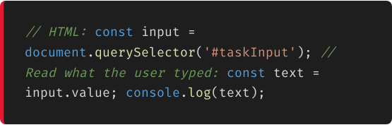
upGrad School of Technology
Selecting Elements
querySelector()
Turns a CSS selector (an id, a class, a tag) into a real JavaScript variable.
Select by ID querySelector('#id')
Select by Class querySelector('.class')
Select by Tag querySelector('button')

Slide 7
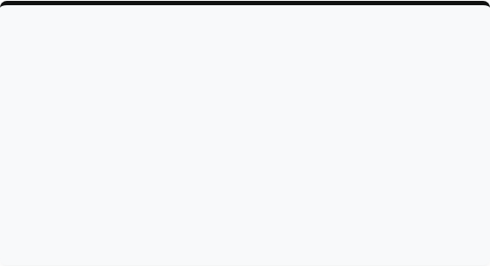



upGrad School of Technology
querySelector vs querySelectorAll
Both use CSS selectors—but they return different results.
querySelector()
querySelectorAll()
•
Returns the first matching element.
•
Returns all matching elements.
•
Return type: Element
•
Return type: NodeList (Looks like an array).
•
Returns null if nothing matches.
•
Returns an empty NodeList if nothing matches.

Slide 8
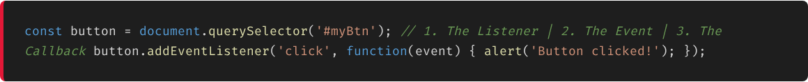
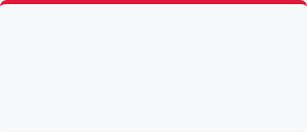
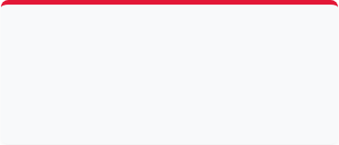
upGrad School of Technology
Handling Events
Three pieces, one line — connect user actions to your code using the modern addEventListener() method.
1. The Listener
2. The Event
3. The Callback
The element you want to watch (e.g., button).
The string that names the action (e.g., 'click', 'submit').
The function that runs every time the event fires.

Slide 9
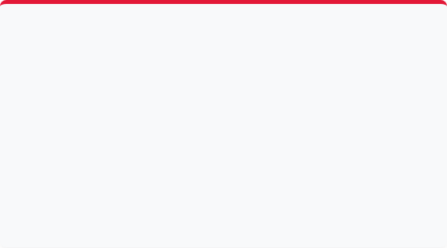


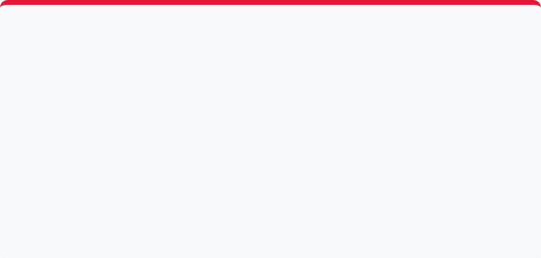


Common DOM Events
upGrad School of Technology
click
submit
Fires when the user clicks a button, link, icon, or any clickable element.
Fires when a form is submitted (e.g., hitting Enter in an input or clicking submit).
Always use e.preventDefault()!
input
keydown
Fires every single time the value inside an input field changes.
Fires whenever a keyboard key is pressed down. Check e.key to verify which key.

Slide 10
upGrad School of Technology
Event Delegation
Listen on the parent, react to the clicked child.
One listener on a parent handles events for all current and future elements.

Slide 11
upGrad School of Technology
Add Task Workflow
Every new element added to the DOM follows the same four-step process:
1. Read Input input.value.trim() - Read the user's text and remove whitespace.
2. Validate if (!text) return; - Ignore empty submissions to prevent blank tasks.
3. Create Element document.createElement("li") - Creates the element in Browser Memory (not visible yet).
4. Show on Page list.appendChild(task) - Appends to the DOM and makes it visible. Clear input after.

Slide 12

upGrad School of Technology
Questions?
Let's build the project!

